Slide 1
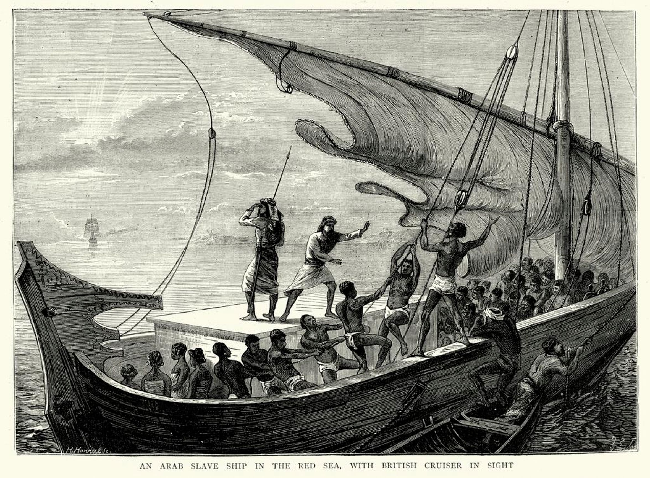
Slavery and Race

Slide 2
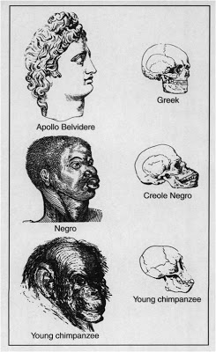
Social Darwinism and Eugenics

Slide 3
Five Fallacies of Racism Desmond and Emirbayer (2009)
Individualistic fallacy: racism based on prejudice and individual acts of racism
Legalistic fallacy: We are legally equal – that’s what matters; in principle versus in practice
Tokenistic fallacy: Since some succeed, all can succeed (Obama and Oprah; Ramaphosa)
Ahistorical fallacy: History does not matter, its over now, lets move on (embeddedness of discourse, representations ignored)
5. Fixed fallacy: Asks ‘has racism increased or decreased?’ – measures racism on one axes – often physical violence; ignores psychic and systemic damage

Slide 4
Race: Key terms
Racialisation: the tendency to classify based on race; basis for social exclusion and inequality
Racism: system insists that one ‘racial’ category is innately superior or inferior
Discrimination: any action that involves treating various categories of people unequally
Institutional discrimination: law and social institutions can treat different categories of people unequally e.g. affirmative action: based on race and gender

Slide 5
Prejudice: rigid and irrational generalisation about a group; ranges from aversion to hostility.
Stereotyping: combined prejudices; exaggerated description, selected facts, culturally embedded, in and out groups
Genocide: extermination of a category of people

Slide 6
Dealing with “Difference’’ and Domination Three Approaches to Living together
Pluralism/multiculturalism: racial and ethnic groups are distinct, but have equal social standing
Assimilation: process whereby minorities gradually adopt patterns of dominant culture (integrationism) Mimicry.
Segregation: physical and social separation of people; Results in social stratification

Slide 7
Race in South Africa
Is there such a thing as a South African identity?
How have our identities changed over time? Since 1994?
How might they continue to change?
Racial Projects

Slide 8
1870
1910
1948
1994
COLONIALISM
SEGREGATION
APARTHEID
Racialized
Disenfranchisement
Racialized
Dispossesion
Authoritarian
White Supremacy

Slide 9
Non-white

Slide 10
Critique of Colour-Blindness
Zimitri Erasmus
Race is ‘nowhere and nothing’ – the ‘colourblind’ view
Race is ‘everywhere and everything’ – the ‘essentialist’ view
Suggests we view ‘race’ as a political construct – about power.

Slide 11
Can the past exist in the Present
• Racism – as pain, as outrage, as dehumanising
• Apartheid’s costs: work, education, belonging, property and health (Hayley’s story)
• White shame, negligence, ambivalence, anger

Slide 12
